Slide 1
CI/CD PIPELINES
Presentator - Rajat Soni
Guided By : Bikash Maharana
Mehul Kartikeyan

Slide 2
Agenda
Introduction
Key features
Tools & Technologies
Installation of Docker and Jenkins
Architecture & Workflow
Artifect
Server Credential
Demo screenshot
Benefits & Next-Steps

Slide 3
Introduction
Project scope:
Design and implement a robust Continuous Integration and Continuous Deployment (CI/CD) pipeline using Jenkins. The pipeline will automate the build, test, and deployment processes for two microservices: one developed in Python and the other in Java using the Spring Boot framework.
The pipeline will ensure code quality, version control integration (e.g., Git), environment consistency, and fast feedback loops. It will be capable of handling dependencies, running automated tests, and deploying to development, staging, and production environments seamlessly.

Slide 4
Key Features
Integration with Git for source control management.
Automated build and test stages for both Python and Spring Boot applications.
Artifact packaging and storage (e.g., using Maven).
Environment-specific deployment configurations.
Integration with Docker and Kubernetes.
Notifications and reporting (via email or Slack).
Rollback mechanisms in case of failed deployments.

Slide 5
Tools & Technologies:
Jenkins (pipeline as code with Jenkinsfile)
Git (GitHub/GitLab/Bitbucket)
Python, Java Spring Boot
Docker
Maven (for Java), pip (for Python)
Artifact repository (e.g., Maven)
Testing frameworks (e.g., JUnit, PyTest)
Webhooks and notifications

Slide 6
Overview of Docker:
Open‑source container platform that enables packaging applications and all their dependencies into lightweight, portable containers.
Ensures a consistent runtime across development, testing, and production, eliminating the “works on my machine” problem.
Run the same container on your laptop, a server, or the cloud—with no surprises
Overview of Jenkins:
An open‑source automation server for building, testing, and deploying software supporting both Continuous Integration (CI) and Continuous Delivery/Deployment (CD) .
Connect itself with different agent like Docker and the cloud agents.

Slide 7
Installation of Docker and Jenkins
Installation of Docker (Version-22.3.1) :
curl -fsSL https://download.docker.com/linux/ubuntu/gpg | sudo gpg --dearmor -o /usr/share/keyrings/docker-archive-keyring.gpg
echo \
"deb [arch=$(dpkg --print-architecture) signed-by=/usr/share/keyrings/docker-archive-keyring.gpg] \https://download.docker.com/linux/ubuntu \ $(lsb_release -cs) stable" | \
sudo tee /etc/apt/sources.list.d/docker.list > /dev/null
sudo apt install docker.io
Installation of Jenkins(version-2.426.3):
bash
CopyEdit
curl -fsSL https://pkg.jenkins.io/debian-stable/jenkins.io.key |
sudo tee /usr/share/keyrings/jenkins-keyring.asc > /dev/null
echo deb [signed-by=/usr/share/keyrings/jenkins-keyring.asc] \https://pkg.jenkins.io/debian-stable binary/ | \ sudo tee /etc/apt/sources.list.d/jenkins.list > /dev/null
sudo apt install jenkins -y

Slide 8
Architecture and Workflow
Diagram : Github → Jenkins Pipeline→ Build docker image →Docker Run( Run Python script) → call the API from browser → Database data from table → JSON output
Github
Docker Run with the bind IP
Database (Table-Employee detail)
Jenkins pipeline (Docker Agent)
Service in ubuntu server
Docker Build Image (building dependency)
Server IP call with the API endpoint
Browser
JSON Data

Slide 9
Artifect
There are two project of the Pipeline.
Python Pipeline
Python script
Docker file
Jenkins file
Configuration requirements
Spring Pipeline
Table connection
Controller with end point file
Main running application file
Docker file
Jenkins file
Pom file

Slide 10
Server Credentials
Database configuration :
Host - 10.36.0.134
Database - Postgresql
User - remoteuser1
Database Name - postgres
Password – 12345678
Server configuration : Quality server
Host - 10.36.0.134
User - appadmin
Password - redh@t
Jenkins:
HTTP url -10.36.0.134:8080 Username - admin
Password - 12345678
Email id - test@jindalsteel.com
Name - admin
spring service url –10.36.0.134:8090
Python service url-10.36.0.134:8000

Slide 11
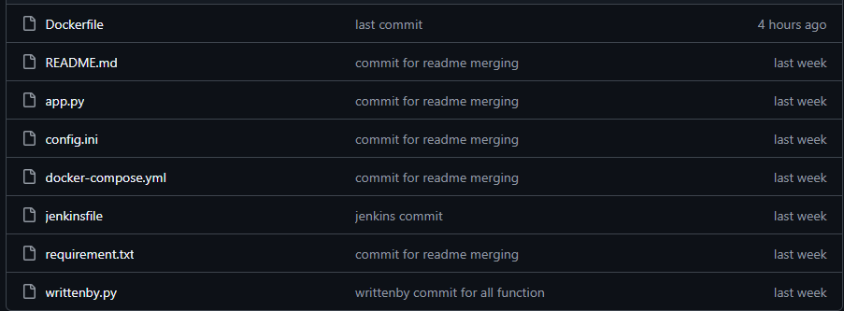
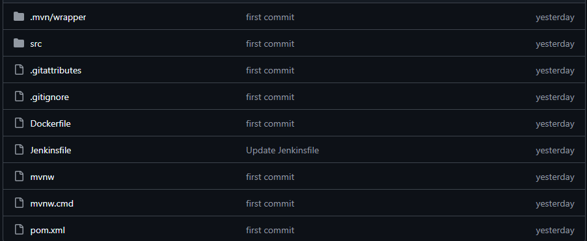
Demo Screenshot

Slide 12
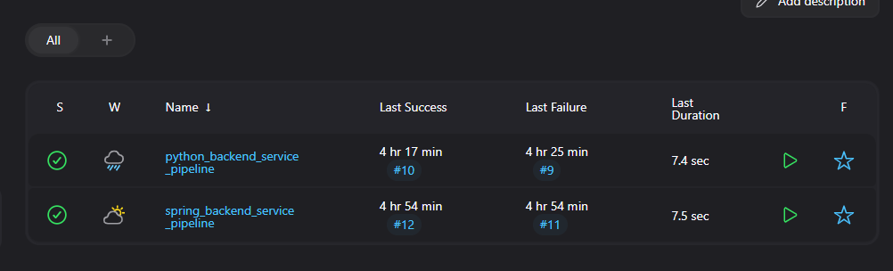
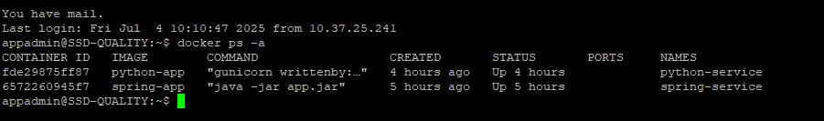
Demo Screenshot

Slide 13
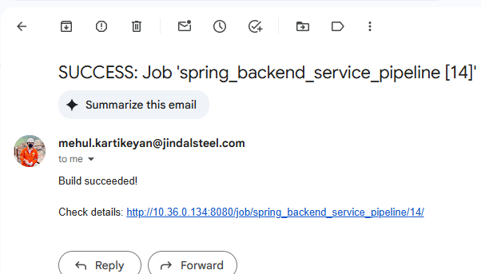
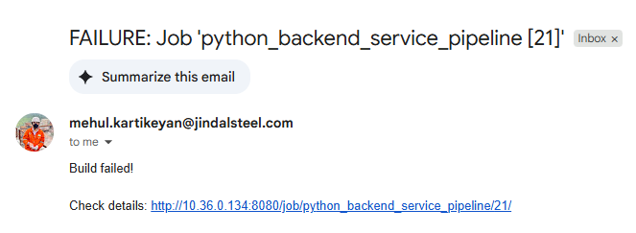
Demo Screenshot

Slide 14
Benefits & Next Steps
Automation: No manual deployment.
Consistency: Every run uses same Docker image.
Scalability: Multiple replicas via orchestration (Docker Compose, Kubernetes).
Next:
Add integration tests.
Deploy to staging or Kubernetes..

Slide 15
THANK YOU

